Slide 1
5G Coverage and Performance

Slide 2



From 4G to 5G Transition
Today – 4G Access
Device attaches to LTE/4G radio and Evolved Packet Core (EPC)
Early 5G – Non-Standalone (NSA)
Device attaches to 5G-NR, which routes either via 4G Base Station to EPC, or direct to EPC
4G acts as control plane
5G Standalone (SA)
Device attaches to 5G-NR and 5G Core Network.
EPC
4G
5G-CN
5G

Slide 3
5G NSA field trials and testing
5G Non-Standalone (NSA) is being largely adopted for the rollout of 5G networks
It is key to investigate how 5G NSA performs in the wild
Large-scale measurement campaign on 5G NSA deployments for four Mobile Network Operators (MNOs) in Rome, Italy
Empirical analysis of the 5G coverage and performance

Slide 4
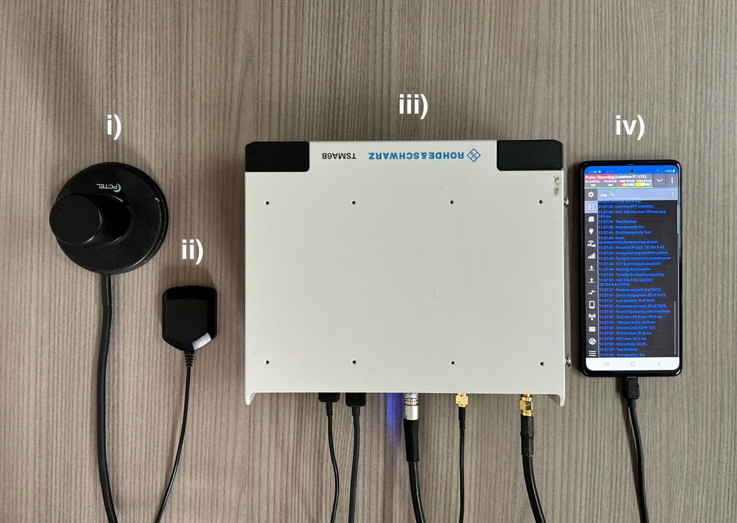
Measurement Setup and Campaign
Two MNOs (Op1-Op2) offering 4G and 5G NSA connectivity in Rome, Italy
Measurements period: 7 weeks (December 2020 - January 2021)
Campaign organized in “sub-campaigns”: different days, different times of the day and different locations
Three mobility scenarios:
Indoor Static (IS): measurements indoor
Outdoor Walking (OW): measurements while walking outdoor
Outdoor Driving (OD): measurements while driving a car
RF antenna
GPS antenna
R&S TSMA6 scanner
5G capable UE
For network analysis, troubleshooting, visualization, and data exporting, we used the R&S ROMES software
Notes:
Outdoor Walking (OW): measurements while walking (average speed of 3.53 km/h, with stops due to traffic lights)
Outdoor Driving (OD): measurements performed while driving a car (average speed of 19.4 km/h, with stops due to traffic lights)

Slide 5
Passive Measurements
TSMA6 detects and decodes downlink control information
Measurements 4G and 5G at each location
Dataset features:
Spatial (Latitude and Longitude) and temporal (Date, Time) information
Carrier frequency identifiers
Signal strength/quality indicators
Notes:
4G: measurements on the Reference Signal (RS) sent by 4G PCIs
5G: measurements on the SSS, sent by 5G PCIs in the SSBs:
SS Reference Signal Received Power (SS-RSRP)
SS Reference Signal Received Quality (SS-RSRQ)
SS Signal to Interference and Noise Ratio (SS-SINR)

Slide 6
Active Measurements
Android application Qualipoc running on a Samsung S20 5G-capable device
Throughput Test: Speedtest by Ookla jointly with R&S Qualipoc to measure the end-to-end downlink (DL) and uplink (UL) throughput
throughput (donwlink, uplink)
Latency/Reliability Test: Qualipoc interactivity test with the real-time online gaming traffic pattern.
RTT
interactivity score, i.e., combination of Round Trip Time (RTT), Packet Delay Variation (PDV), Packet Error Rate)
Notes:
4G: measurements on the Reference Signal (RS) sent by 4G PCIs
5G: measurements on the SSS, sent by 5G PCIs in the SSBs:
SS Reference Signal Received Power (SS-RSRP)
SS Reference Signal Received Quality (SS-RSRQ)
SS Signal to Interference and Noise Ratio (SS-SINR)

Slide 7
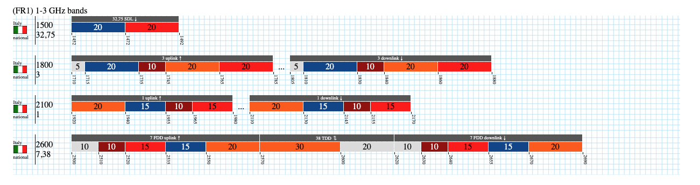

Carrier frequency identifiers
https://www.spectrummonitoring.com/frequencies.php?market=I
Notes:
4G: measurements on the Reference Signal (RS) sent by 4G PCIs
5G: measurements on the SSS, sent by 5G PCIs in the SSBs:
SS Reference Signal Received Power (SS-RSRP)
SS Reference Signal Received Quality (SS-RSRQ)
SS Signal to Interference and Noise Ratio (SS-SINR)

Slide 8
Signal Indicators
RSRP: Indicates the average power of the received reference signal spread over the full bandwidth. It is affected by distance, nearby buildings, walls, weather conditions, etc.
Range: -144dBm (bad) to -44dBm (good)
RSRQ: Indicates the quality of the received reference signal. It is defined as RSRQ = N x RSRP / RSSI, where N is the number of Physical Resource Blocks.
Range: -19.5dB (bad) to -3dB (good)
SINR: Indicates the signal-to-noise ratio of the received signal. In other words, it measures the ratio of the desired signal power to the sum of the power of the interfering signals and can be used to measure the quality of the connection
Range: -20dB (bad) to 20dB (good)
Respective signal indicator ranges for 5G slightly differ.

Slide 9
Behind the Doors: 4G and 5G Datasets

Slide 10
Data Sources
Passive dataset:
One .csv file per technology (4G, 5G, NB-IoT)
Reports information such as Timestamp, Location, Speed and signal strength identifiers for each detected neighboring cell (e.g., RSRP, RSRQ, SINR)
Other available information such as mobility scenario and sub-campaign identifier
For 4G (only) an estimated location for each cell is also provided
Structure of the dataset:
Time series - consists of ‘frequency scans’
`batch` of samples sharing features such as Date, Time, Latitude, Longitude, and Frequency.
Active dataset:
Two .csv files, one per performance test (Speedtest and Gaming).
Indicators related to the radio and physical layers, as well as QoS and QoE indicators.
Time series but event-based — the dataset was updated at millisecond-level granularity
Row records with ’?’ represent unaltered values.

Slide 11
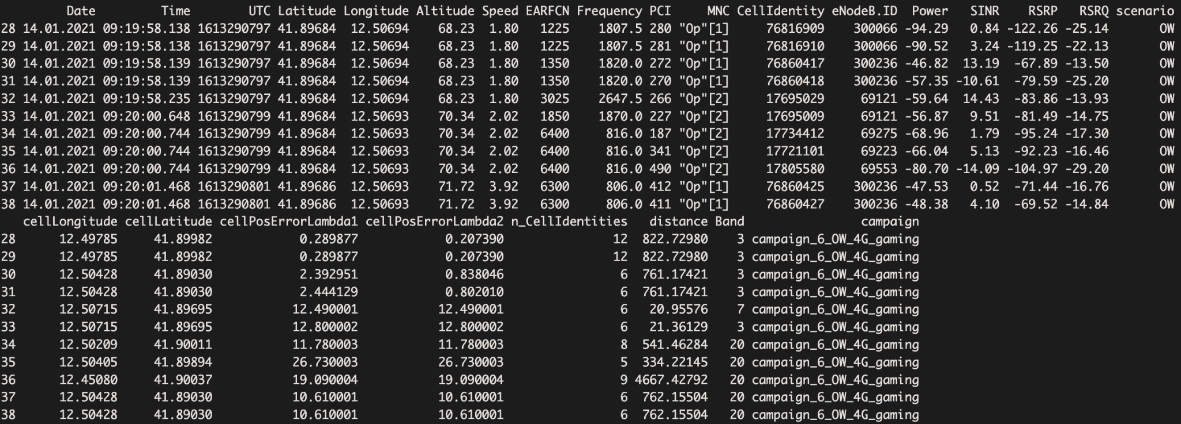
Example (4G) - Passive dataset

Slide 12
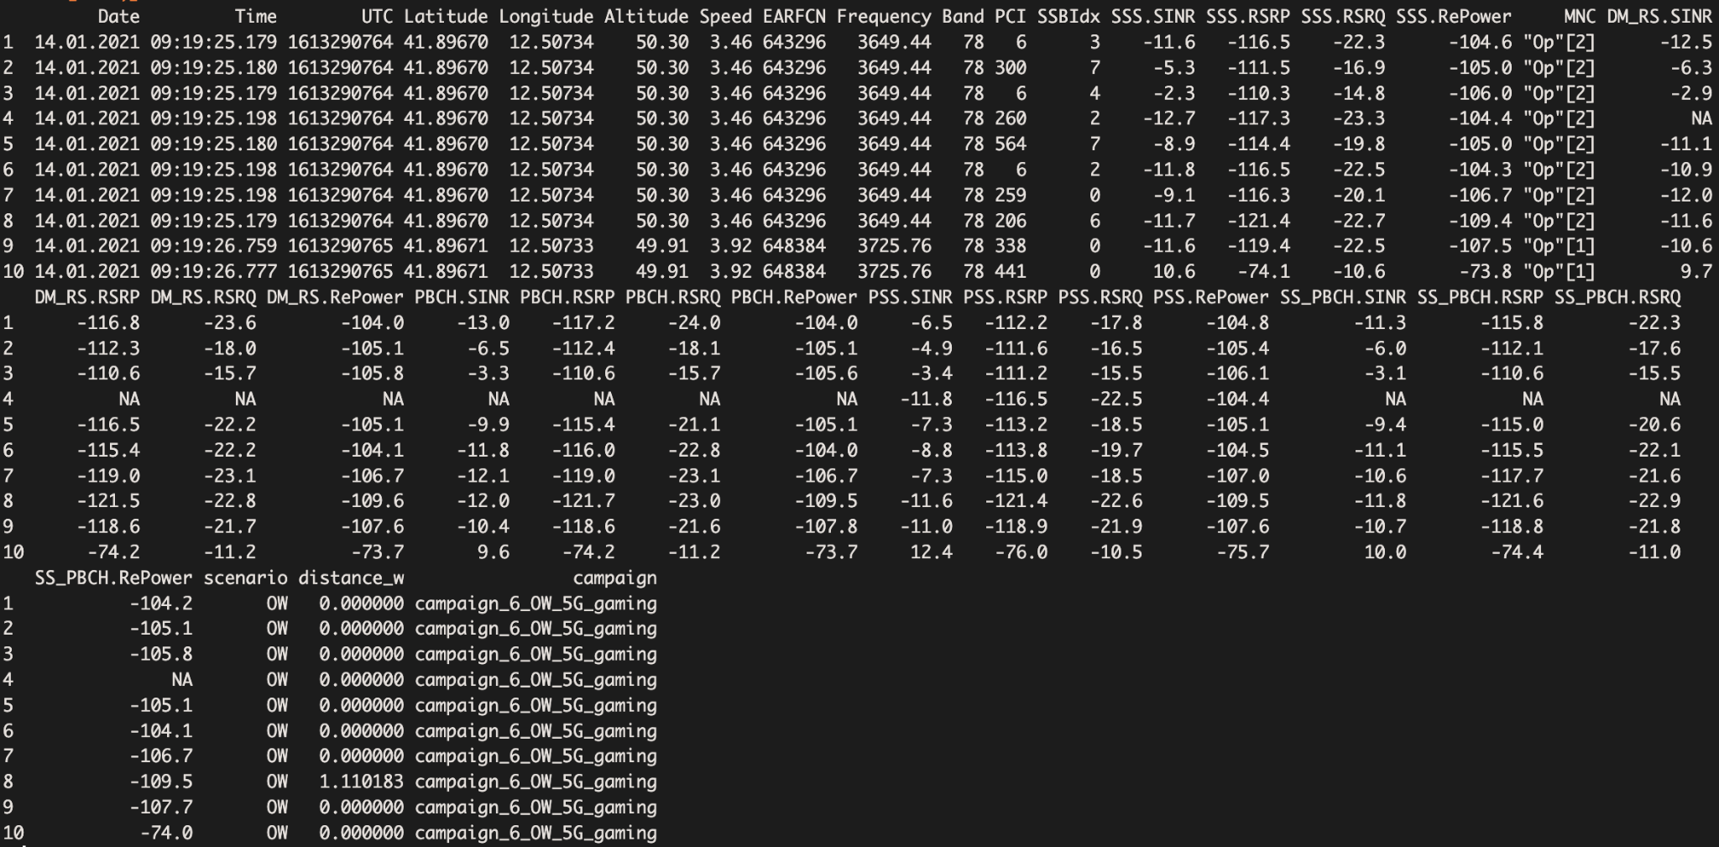
Example (5G) - Passive dataset

Slide 13
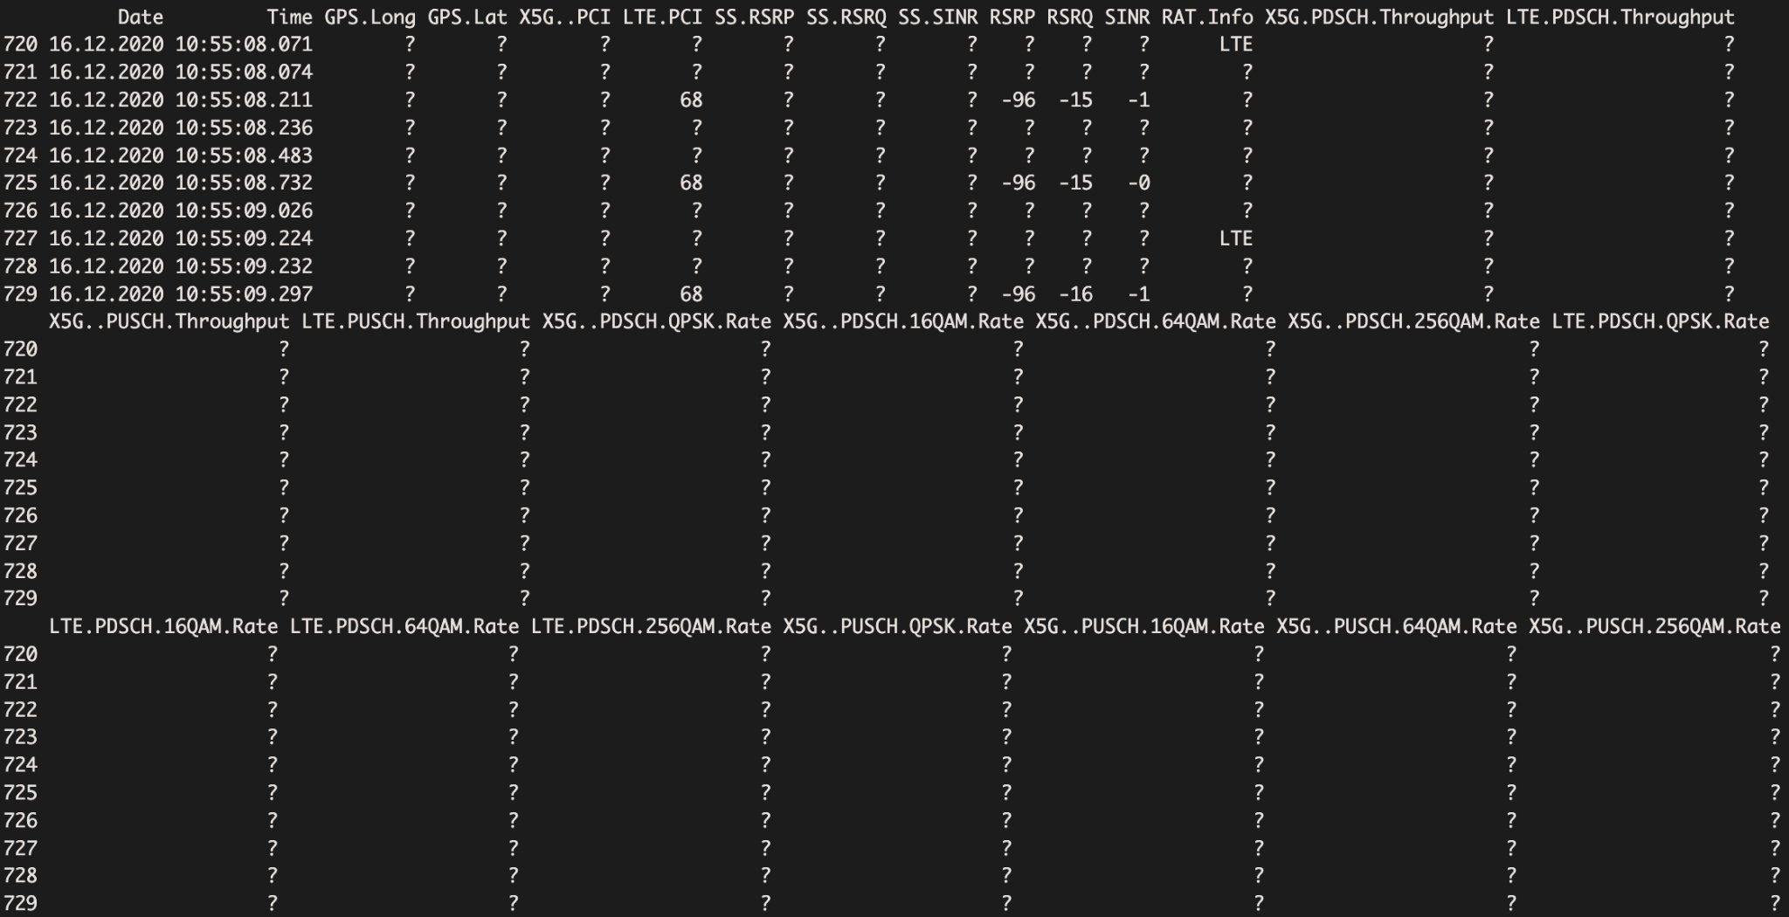
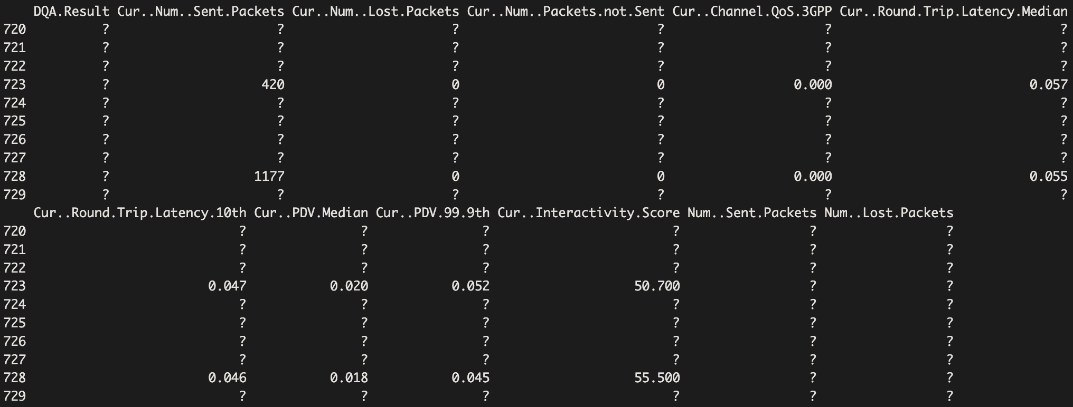
Example - Active

Slide 14
Post-Processing challenges
Cleaning: Remove metadata and measurement configuration details from raw data files
Missing Data: How to handle?
e.g., MNC missing - Action: insert it by using other features (such as Frequency)
e.g., GPS missing - Action: if indoor campaign, insert it manually
Mutate Data: Add features useful for the analysis
e.g., location, mobility scenario, folder structure (for future segmentation), etc.
Invalid Data: Requires domain knowledge
Look for outliers and extreme values
Determine either extreme (of interest) behavior or measurement error

Slide 15
A few numbers
Dataset collected during a period of 7 weeks (December 2020 - January 2021)
2 operators (Op1 and Op2)
4 4G Bands (1, 3, 7, and 20)
1 5G Band (n78)
Number of samples:
Passive
4G: 528K (243K for Op1 and 285K for Op2)
5G: 8.14M (1.12M for Op1 and 7.02M for Op2)
Active
555 Speedtest sessions (197 for Op1 and 358 for Op2)
1158 Real-time online gaming sessions (657 for Op1 and 501 for Op2)
Additional information regarding the dataset available in the paper.

Slide 16
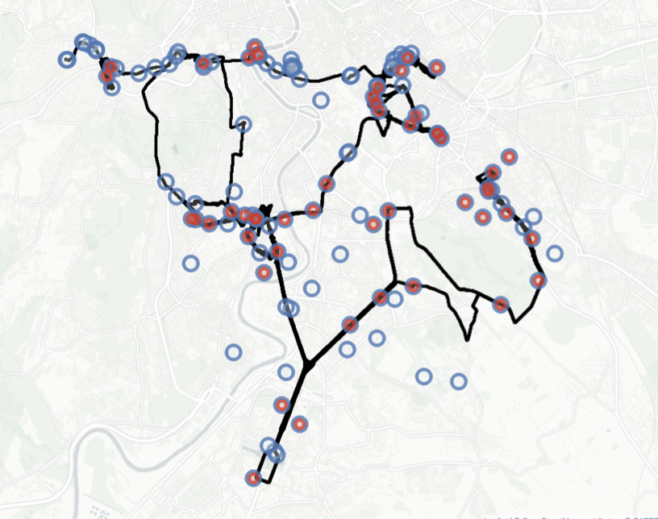
5G Deployment map
Spatial representation of the radio network deployment for 𝑂𝑝1. The blue and red markers indicate the estimated positions of 4G and 5G base stations, respectively. The black line in the background indicates the routes during the entire measurement campaign.

Slide 17
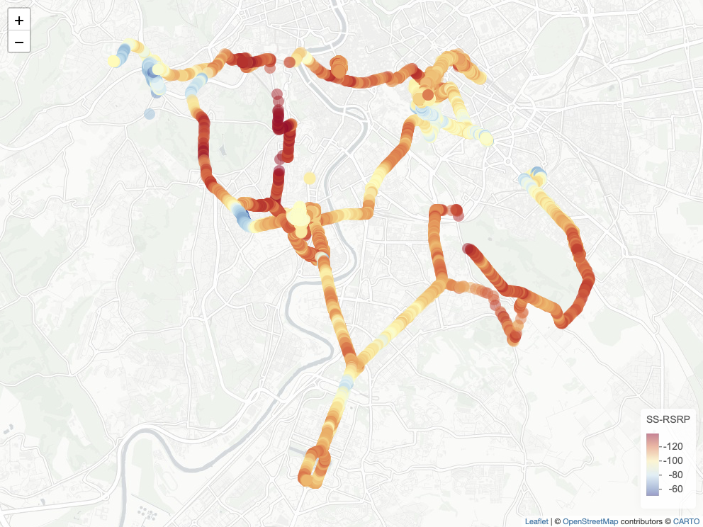
5G Coverage map
Highest SS-RSRP [dBm] measured across the 5G PCIs of Op1 detected at the locations traversed during OW and OD sub-campaigns.

Slide 18
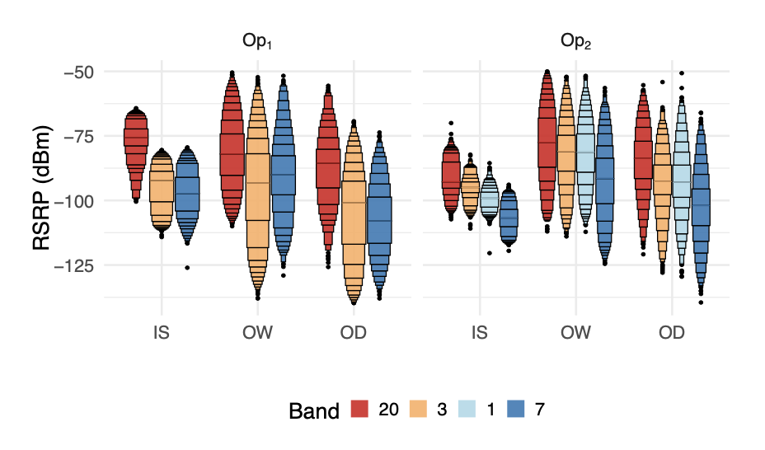
4G Coverage
Distribution of 4G RSRP [dBm] across carrier frequencies (in a letter-value plot format and order by highest to lowest frequency)

Slide 19
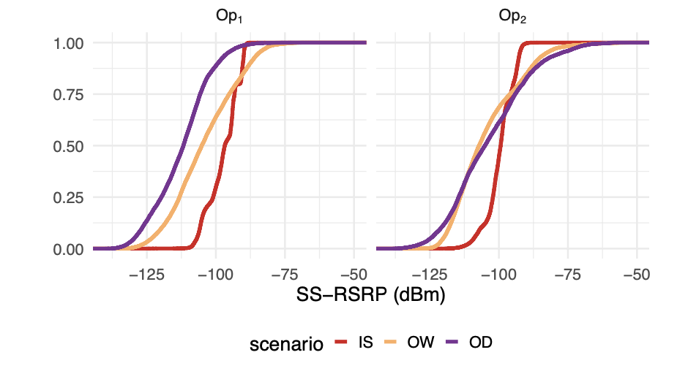
5G Coverage
Distribution of 5G SS-RSRP [dBm] (in an ecdf format), for 𝑂𝑝1 and 𝑂𝑝2 and grouped by scenario.

Slide 20
Significance Tests
Kruskal-Wallis (non-parametric): Determine statistical significance between the means of more than two independent groups Assumptions:
No assumptions
Null Hypothesis: The means across all groups are equal
Alternative Hypothesis: At least one group mean is different from the rest
if p-value is less than a significance level (e.g., 0.05), we can reject the null hypothesis
Dunn’s Test (non-parametric): If Kruskal-Wallis shows statistical significance, conduct Dunn’s test to determine which groups are different (test each combination of groups)

Slide 21
Operator and Technology comparison
Technology | IS | IW | OW | OD
LTE | 0.2906 | 0.0274 * | 0.2480 | 0.3581
5G | 0.1594 | 0.00033 *** | 0.1152 | 0.1439
Operators have significant differences especially for Indoor scenarios.
Operator comparison
Operator | IS | IW | OW | OD
1 | 0.0021 ** | 2.3e-09 *** | 0.0117 * | 1e-05 ***
2 | 0.0133 * | 1e-06 *** | 0.00078 *** | 1e-05 ***
Different technologies have significant differences for both operators.
Technology comparison

Slide 22
Assignment

Slide 23
How to access the dataset
Download the dataset here: https://zenodo.org/records/8224890
Important complementary material:
Article: K. Kousias et al., ”A Large-Scale Dataset of 4G, NB-IoT, and 5G Non-Standalone Network Measurements” in IEEE Communications Magazine, vol. 62, no. 5, pp. 44-49, May 2024, doi: 10.1109/M- COM.011.2200707 (https://ieeexplore.ieee.org/abstract/document/10239125 )
Check the description file for a complete list of all available features

Slide 24
What to evaluate
Coverage and performance analysis
Given a selected number of different (sub-)campaigns, compare the coverage and/or performance (throughput/latency) of different operators (further dissect per frequency band) and different technologies (4G, 5G).
Given two or more sub-campaigns at the same location (e.g., repetitions of indoor/outdoor campaigns), show how the coverage and/or performance changes over time.
Given a single operator, compare the coverage and/or performance across different locations or scenarios. HINT: Particularly interesting for OD campaigns
Make sure to carry out statistically significance tests among different groups!

Slide 25
Contact Points
ozgua@ifi.uio.no
konstako@ifi.uio.no

